Slide 1
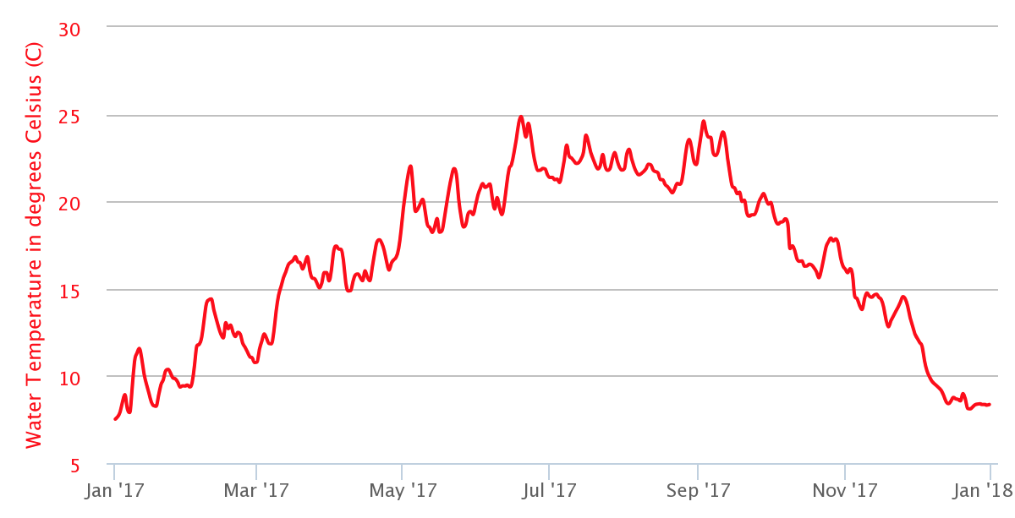
DATA IN THE CLASSROOM: LEVEL 1
Analyzing Temperature Data
Analyzing Seasonal Water Temperature Data: Let’s take a virtual trip to the San Francisco Bay estuary to investigate water temperature. Answer the questions using the water temperature graph.
Water Temperature in the San Francisco Bay estuary, January–December 2017
Time
Question | Answer
What parameter is on the x-axis?
What parameter is on the y-axis?
In 2017, water temperature was lowest during which month of the year?
In 2017, water temperature was highest during which months?
Any fish that lives at this location throughout the year would have to be well-adapted to temperatures ranging from approximately __________ °C to __________ °C. *Write the 2 missing temperature values in the box at right.
Type your answers directly into the boxes.

Slide 2
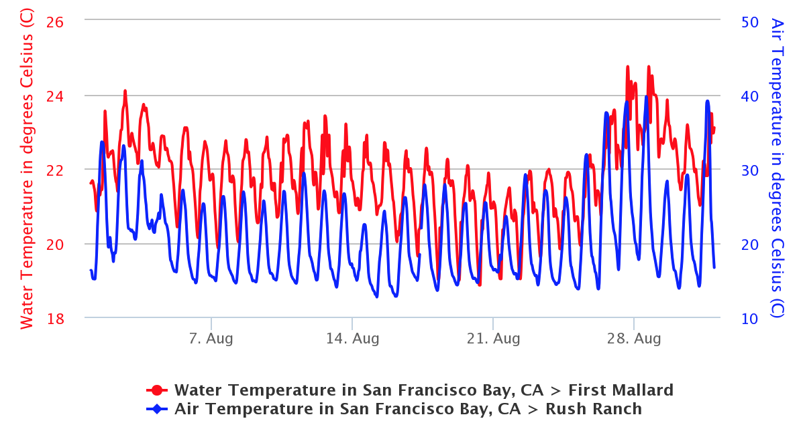
DATA IN THE CLASSROOM: LEVEL 1
Analyzing Temperature Data
What Causes Water Temperature to Change? An extreme heat wave hit San Francisco Bay in August 2017. Between August 21st and 28th, air temperature increased by 16 °C. How did water temperature change during the same period of time? Answer the questions using the graph of air and water temperature below.
Water and Air Temperature: San Francisco Bay estuary, August 2017
Question | Answer
What parameter is on the primary y-axis (shown on the left)?
What parameter is on the secondary y-axis (shown on the right)?
What does the blue line represent?
What does the red line represent?
Use the data to describe the apparent effect of the heat wave on water temperature at this location.
When water temperatures rise above what is normal, how might organisms be affected?
Type your answers directly into the boxes.

Slide 3
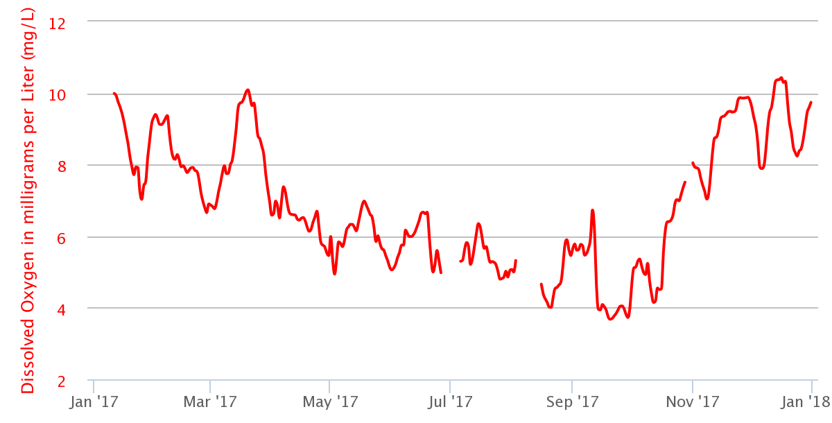
DATA IN THE CLASSROOM: LEVEL 2
Understanding Dissolved Oxygen
Graphing Dissolved Oxygen: Fish, crabs, and other animals that live in estuaries must have enough dissolved oxygen in the water in order to survive. Just how much dissolved oxygen is in an estuary? And how much do concentrations change over time? Create a graph using the online data tool OR use the graph shown below to answer the following questions.
Dissolved oxygen in ACE Basin, South Carolina, January–December 2017
Time
Question | Answer
Approximately, how much dissolved oxygen was in the water at ACE Basin on January 17, 2017?
Dissolved oxygen concentrations were lowest during which month?
A fish that lives in the ACE Basin year round would have to be well-adapted to dissolved oxygen concentrations ranging from approximately _____________mg/L to _____________ mg/L. *Write the 2 missing dissolved oxygen values in the box at right.
Type your answers directly into the boxes.

Slide 4
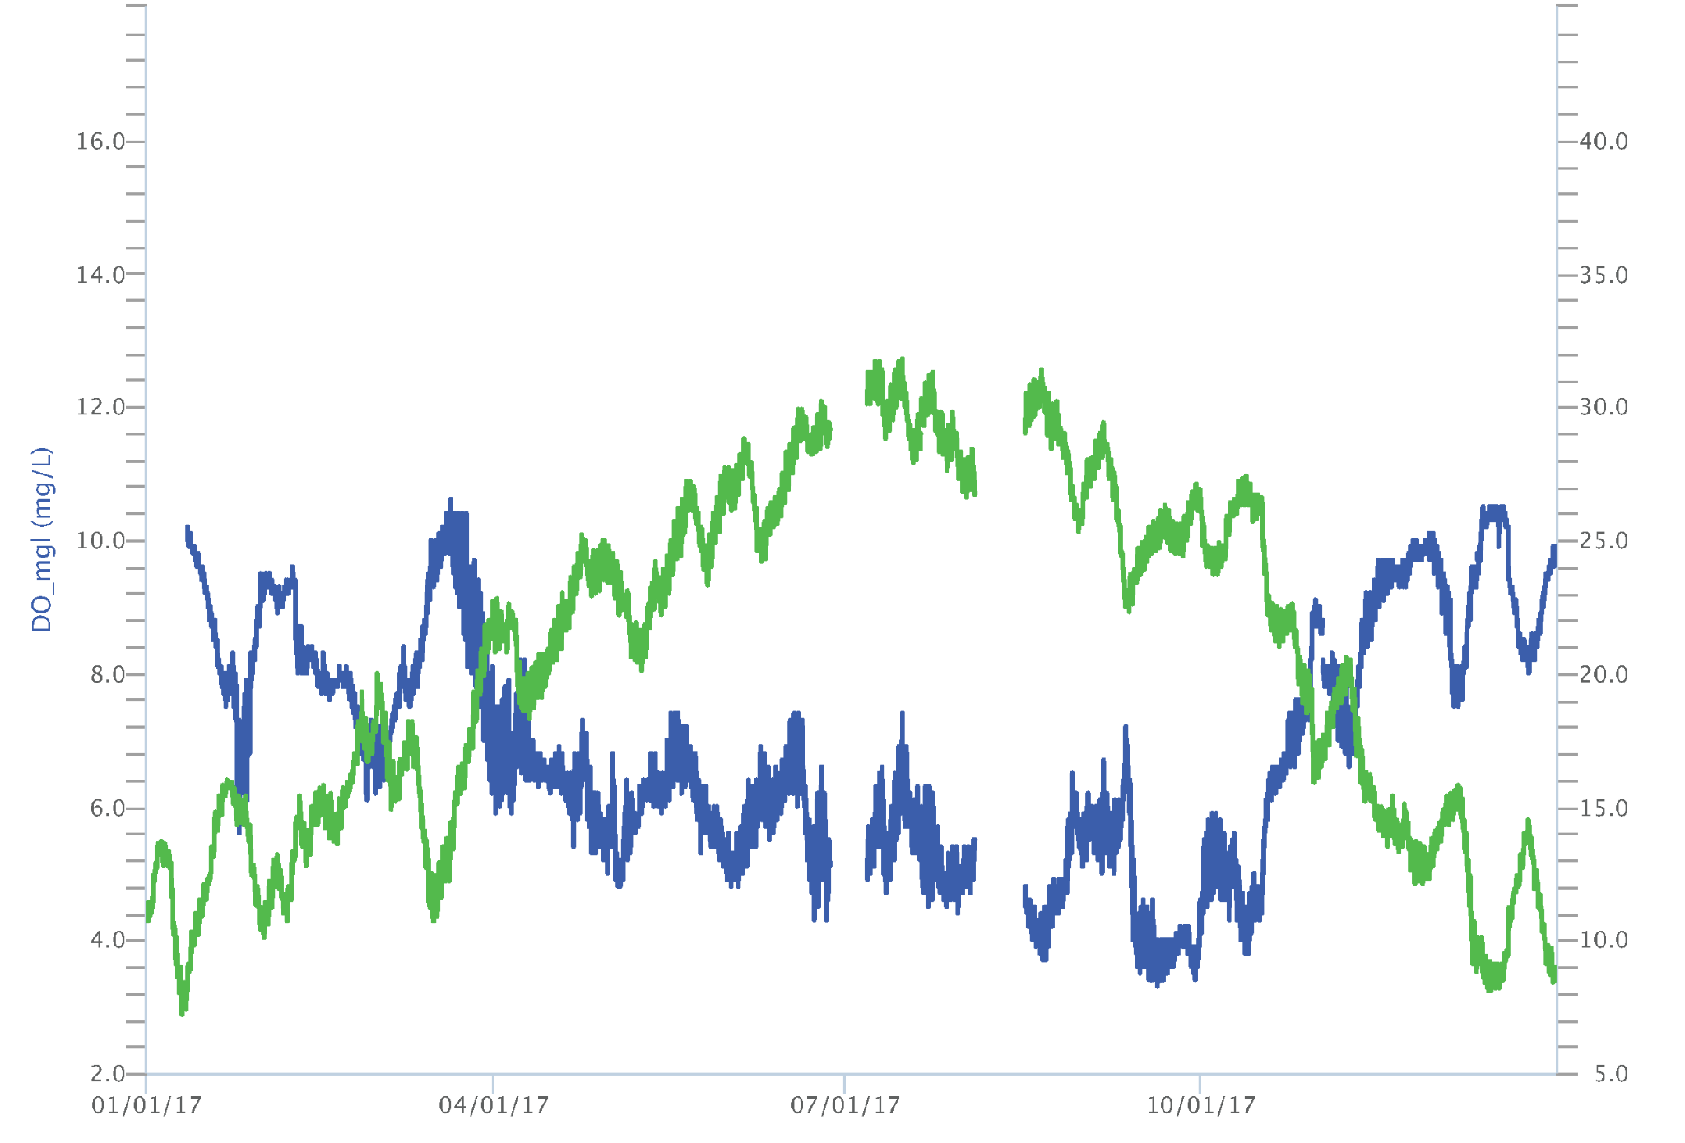
DATA IN THE CLASSROOM: LEVEL 2
Understanding Dissolved Oxygen
What Affects Dissolved Oxygen? Many things can affect dissolved oxygen concentrations, including water temperature. Use the online tools in Level 2 to create a graph similar to the one shown below. Then, answer online Questions 3 and 4 before completing the summary questions below.
Dissolved Oxygen and Water Temperature in the ACE Basin, South Carolina, January–December 2017
Question | Answer
In your own words, describe the relationship between water temperature and dissolved oxygen shown in the graph.
Propose an explanation for the relationship you described above.
Type your answers directly into the boxes.
Dissolved Oxygen (mg/L)
Temperature (℃)
Time (months)

Slide 5
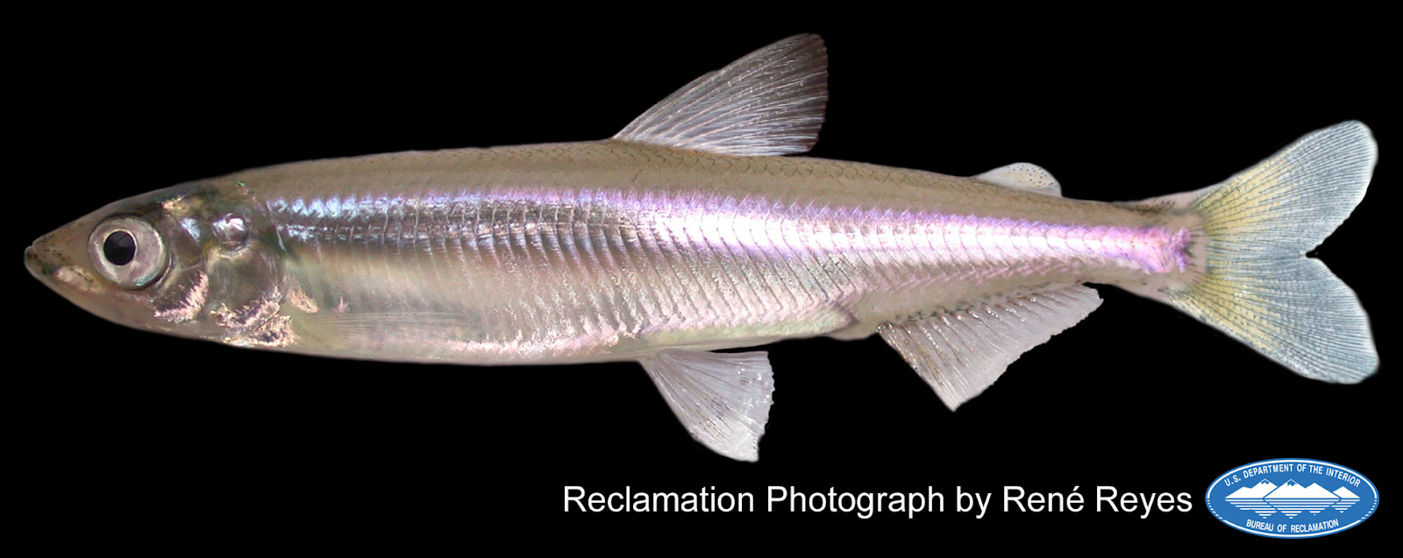
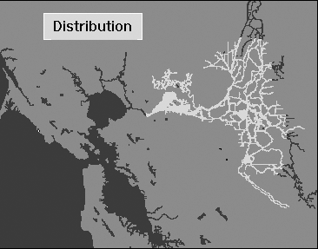
DATA IN THE CLASSROOM: LEVEL 3
Measuring Salinity in Estuaries
Answering a Question with Data: It’s February 2017. A number of endangered fish, called Delta Smelt, have recently been found in the San Francisco Bay (near China Camp station). These fish are usually found in the freshwater rivers that connect to the bay, where salinity is 2 PSU or less. The fish are extremely rare in the saltier waters near China Camp. What may have caused Delta Smelt to be found outside of their normal range?
Typical Range of Delta Smelt
China Camp
Photo (left): the endangered Delta Smelt
Map (right): the range of the the Delta Smelt (shown in light gray) within the freshwater regions of the San Francisco Bay estuary.
Make a Claim: What may have caused Delta Smelt to be found outside of their normal range in February 2017? * Use information from the top of this page to help construct your claim. | My Claim:
Collect Evidence: Use the online data tool in Level 3 to access and analyze salinity data at China Camp station around the time that the smelt were observed. * Record date(s), location and salinity data in the box at right. | My Evidence:
Reasoning: Does the salinity data support your claim about what may have caused the fish to be found so far away from their typical range? Explain your reasoning in the box at right. | My Reasoning:
Type your answers directly into the boxes.

Slide 6
DATA IN THE CLASSROOM: LEVEL 4
Spawning of the Atlantic Sturgeon
Predicting the Return of the Atlantic Sturgeon:
Populations of Atlantic sturgeon have been in decline over the past century. Estuaries are important for the survival of this species because sturgeon use them to spawn and have their young. The location and timing of their spawning migrations are therefore of primary importance. Your mission is protect the spawning populations of this species. To begin to do this, you will need to predict when Atlantic Sturgeon will migrate into the freshwater reaches of an estuary to spawn. To get started, select an estuary and completed the fields below.
Get the Data: Once you have selected an estuary, determine what data you will need. Specifically, which water quality conditions will you examine? And over what period of time? Use the table below to keep track of your progress. See the example in the first row of the table, to help guide your data explorations.
Location: Choose an estuary of interest from the online Fact Sheet. Record the name and location in the box at right.
Make a Claim: Your claim is your prediction about when Atlantic Sturgeon will migrate into the freshwater reaches of an estuary to spawn. Example: Atlantic Sturgeon most likely begin their spawning migrations into the Delaware Bay estuary when water temperatures are ……….
Type your answers directly into the boxes.
Location (station name) | Water Quality Parameter | Range of Dates | Notes
Blackbird Landing | Water Temperature | April 1-30, 2017 | Temperatures were between 13-17°C throughout most of the month
Type your answers directly into the boxes.

Slide 7
DATA IN THE CLASSROOM: LEVEL 4
Spawning of the Atlantic Sturgeon
Interpret the Data: Use the data you collected to answer the following questions.
Protecting the Spawning Populations: In some locations, Atlantic sturgeon are protected as an Endangered species under the Federal Endangered Species Act. Therefore, no fishing of any kind is permitted. Other than fishing, the main threats to the Atlantic sturgeon’s survival are a) declining water quality and b) the dams located along rivers, which prevent them from reaching their spawning areas.
Question | Answer
During what time period is the water temperature within the range for sturgeon to return to spawn?
What is the range of the other water quality parameters during that time period?
Can you identify a time period when all the conditions look right for the sturgeon to return to spawn?
Do the same conditions occur around the same time, year after year?
Type your answers directly into the boxes.
Propose one action that lawmakers or communities around your estuary might take to help protect the Atlantic Sturgeon. Include the time period when these actions would be most beneficial.
Type your answer directly into the box.

Slide 8
DATA IN THE CLASSROOM: LEVEL 5
Design an Investigation
Develop Your Question: Ask a question that can be answered using the data available in the module. Some sample questions are below.
How does a major storm impact water quality conditions in an estuary?
To what extent have dissolved oxygen concentrations in the Chesapeake Bay (or other estuary) become low enough to impact the survival of the Atlantic sturgeon? Note: Studies suggest that dissolved oxygen concentrations of 3 mg/l or less are lethal to sturgeon.
Collect and Analyze Data: Identify the data that you need to answer your question. If possible, paste or attach your data maps or charts to this document.
Construct an Explanation: Does the data support or refute your claim? Use the claim, evidence, reasoning format to help develop your own explanation based on evidence.
Identify a question of interest about water quality in an estuary of interest.
State your claim - your predicted answer to the above question)
Type your answers directly into the boxes.
Estuary (Station Name) | Water Quality Parameter | Range of Dates | Notes
Type your answers directly into the boxes.
Claim: Restate your claim from #1, above.
Evidence: Include specific data from the the data maps, graphs or charts you have analyzed.
Reasoning: Connect the evidence to your claim.
Type your answers directly into the boxes.

