Slide 1
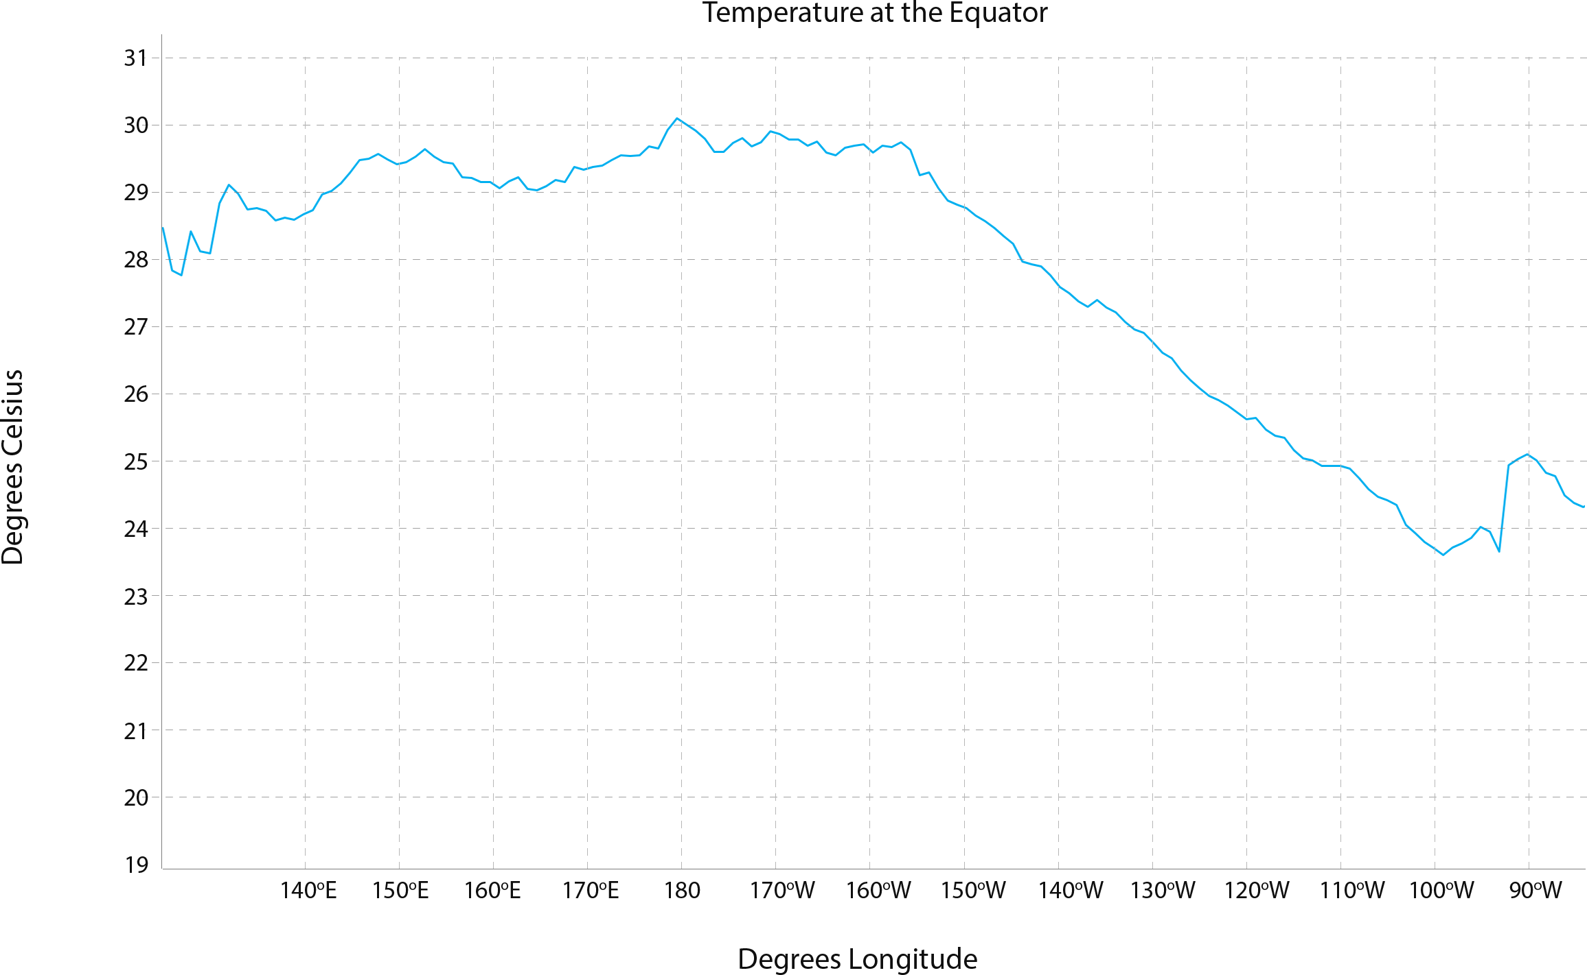
DATA IN THE CLASSROOM: LEVEL 2
Graphing Sea Surface Temperature
At the equator, how does the surface temperature of the Pacific Ocean vary from west to east?
Observe the line graph of sea surface temperature data below. Notice how temperature changes along one line of latitude, in this case along the equator, during December 2015.
What were the monthly average sea surface temperatures along 0° latitude at 140° E? To find out, find 140° E on the x-axis. Then, find the corresponding temperature on the y-axis. Record this temperature in the table below.
What were the monthly average sea surface temperatures along 0° latitude at 180°, 140° W and 100° W? Record these temperatures in the table below.
Use the data in the table to complete the sentence: The data show that surface temperature ………….……… [increased or decreased] by ………...….. degrees Celsius from east to west along the equator..
Longitude | 140° E | 180° | 140° W | 100° W
Sea Surface Temperature (°C)
Type your answers directly into the boxes.
Sea Surface Temperature at the Equator, December 2015

Slide 2
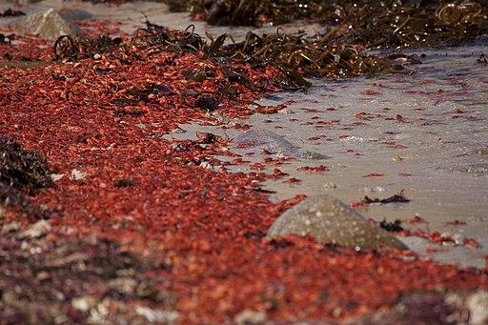
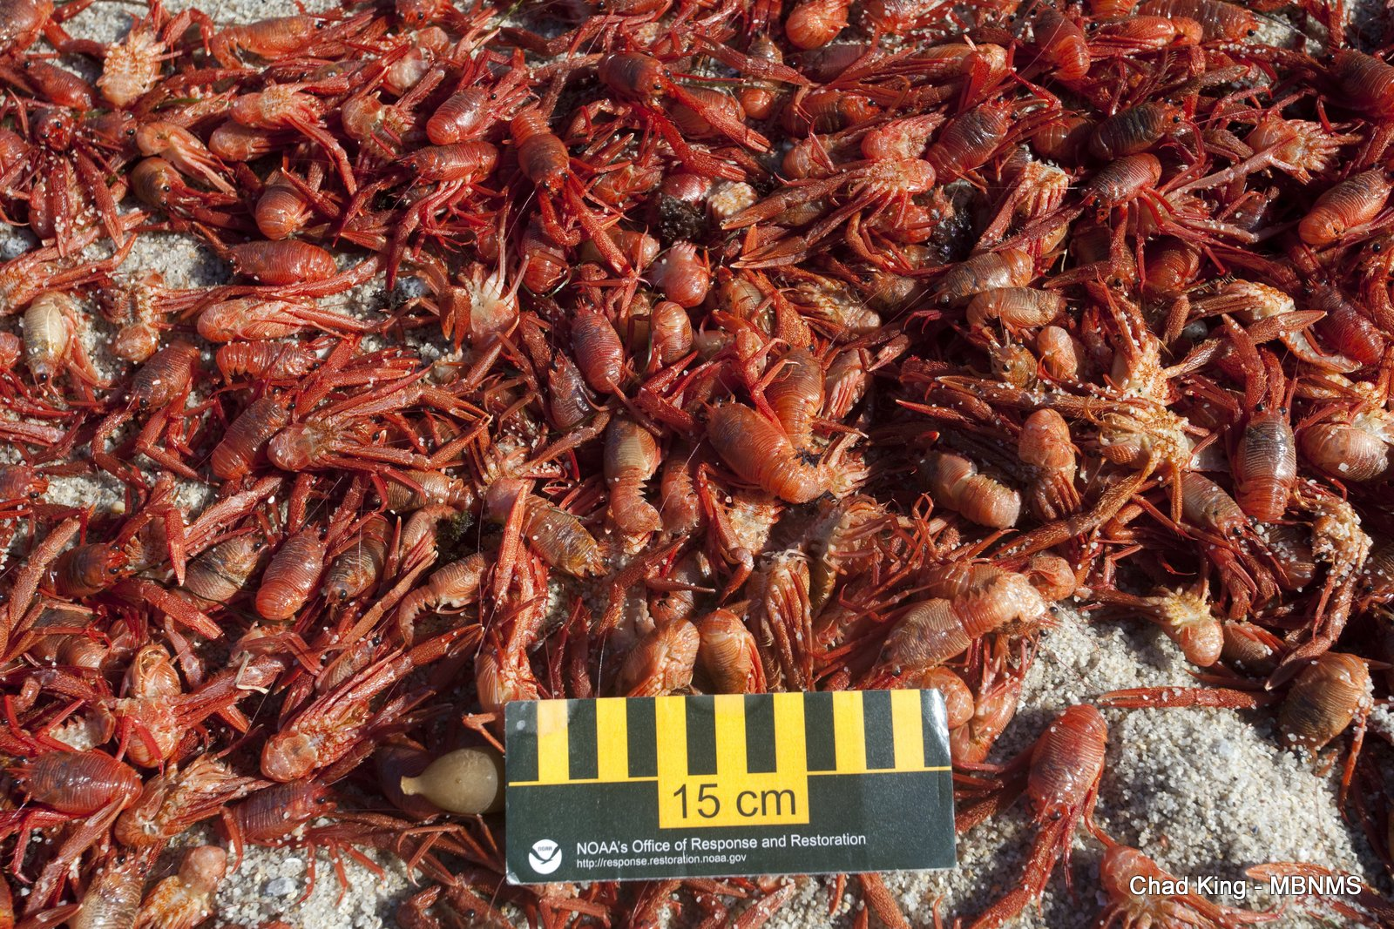
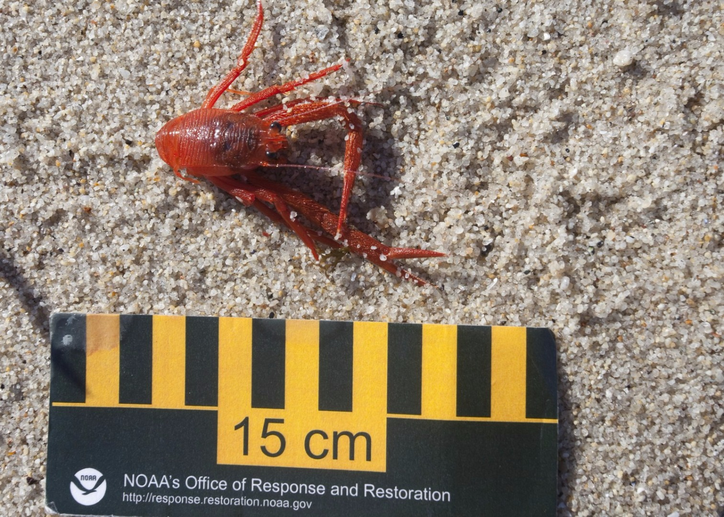
DATA IN THE CLASSROOM: LEVEL 3
Answering a Question With Data
Your Mission: It’s the winter of 2015. The waters along the coast of California are unusually warm. Huge numbers of pelagic red crabs that are typically common in the warmer waters off the coast of Mexico are now washing up along beaches of California (shown in images below). Have the warmer surface waters in California brought this sub-tropical species northward? Could these observations be the result of an El Niño? Your mission is to find out - using data.
Answer a Question With Data: What data would you need to find out whether whether the presence or absence of an El Niño during the winter of 2015 could have caused this event? Make a list below of the specific TEMPERATURE data you might need to answer the question. Hint: can you answer the question by looking at data from only one year? Will you need maps, graphs or both?
Get the Data: Locate the data tool in last section of Level 3 titled ‘Answering a Question with Data.’ Follow the instructions on the web page to access the data you’ll need. Not sure how to create line graphs? Watch the video in Level 3. Or use the sea surface temperature graphs from December 2014, December 2015 and December 2016 on the following pages.
Data set | Date | Map or Graph?
Example: Sea surface temperature | December 2001 | Map
Type your answers directly into the boxes.

Slide 3
DATA IN THE CLASSROOM: LEVEL 3
Answering a Question With Data
Construct an Explanation: Did an El Niño event occur during the winter of 2015? Answer the question using the claim, evidence, reasoning table below.
Drawing Conclusions: Could the presence or absence of an El Niño event during the winter of 2015 have caused huge numbers of pelagic red crabs, typically common in the warm waters of Mexico, to wash up along beaches of California? Use your explanation in #4 above to help draw your conclusions.
Did an El Niño event occur during the winter of 2015? Could an El Niño have caused these crabs to appear along the beaches of California? | My Claim (a simple statement that answers the question):
Include specific data and observations from the graphs & maps you collected. | My Evidence:
Connect the evidence to your claim | My Reasoning:
Type your answers directly into the boxes.
My conclusions:
Type your answers directly into the box.

Slide 4
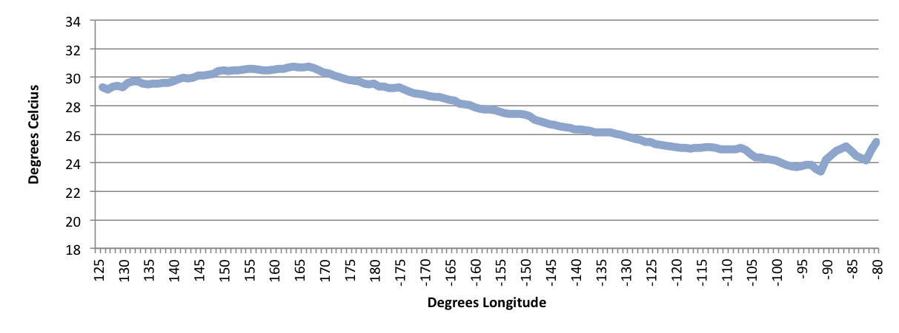
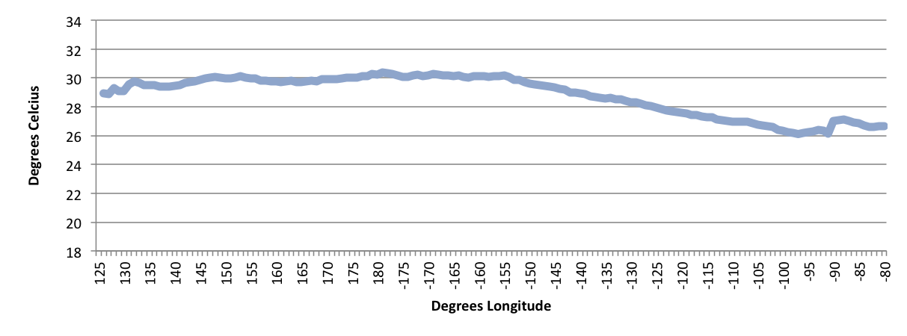
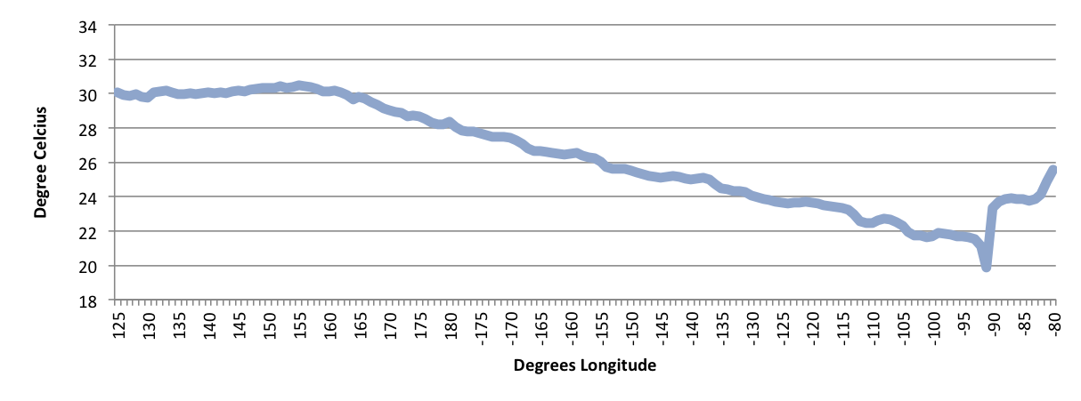
DATA IN THE CLASSROOM: LEVEL 3
Reference Data
Sea Surface Temperature at the Equator, December 2014
Sea Surface Temperature at the Equator, December 2015
Sea Surface Temperature at the Equator, December 2016

Slide 5
DATA IN THE CLASSROOM: LEVEL 4
Exploring El Niño and Chlorophyll Data
Your Mission: You have joined a team of scientists who are studying the effects of El Niño on biological systems in the ocean. Specifically, you are interested in the relationship between sea surface temperature (SST) and productivity, as measured by the amount of chlorophyll. Your task is to determine if there is a relationship between sea surface temperature and the distribution of phytoplankton, and, if so, how this relationship is impacted during El Niño. The team has decided that you will compare two time periods: December 2009 and December 2010.
Form a Hypothesis: What is the relationship between sea surface temperature and phytoplankton concentrations? State your hypothesis by completing the sentence below.
Test Your Hypothesis with Data:
Click on the 2009 and 2010 data maps and graphs presented in the Level 4 online activity. Make some initial observations by answering the questions below.
Analyze the data shown in the 2009 and 2010 data maps and graphs by completing the table below.
My hypothesis | Write the word(s) that completes the hypothesis. Word choices: increases, decreases
During an El Niño event, when sea surface temperatures in the eastern Pacific Ocean increase, the amount of phytoplankton, as measured using chlorophyll-a ………....…………..
Type your answer directly into the box.
Which year shows warmer sea surface temperatures in the eastern Pacific (near the equator)? 2009 or 2010?
Which year shows higher chlorophyll concentrations in the eastern Pacific (near Mexico City)? 2009 or 2010?
Type your answers directly into the boxes.
 |  | Date: 2009 |  | Date: 2010
Latitude | Longitude | SST (°C) | Chlorophyll (mg/m³) | SST (°C) | Chlorophyll (mg/m³)
0° | 140° E
0° | 180°
0° | 140° W
0° | 100° W
Type your answers directly into the boxes.

Slide 6
DATA IN THE CLASSROOM: LEVEL 4
Exploring El Niño and Chlorophyll Data
Construct an Explanation: Do the data in the maps and graphs support your hypothesis? Use the claim, evidence, reasoning table below to explain the relationship between El Niño, ocean temperature and phytoplankton.
What is the relationship between sea surface temperature and phytoplankton concentrations? | My Claim (or hypothesis):
Include specific data and observations from the graphs & maps you observed. | My Evidence:
Connect the evidence to your claim | My Reasoning:
Type your answers directly into the boxes.

Slide 7
DATA IN THE CLASSROOM: LEVEL 5
Design an Investigation
Develop Your Question: Ask a question that can be answered using the data available in the module. Some sample questions are below.
Are El Niño events becoming stronger over time?
Are El Niño events becoming more frequent?
Collect and Analyze Data: Identify the data that you need to answer your question. If possible, paste or attach your data maps or charts to this document.
Construct an Explanation: Does the data support or refute your claim? Use the claim, evidence, reasoning format to help develop your own explanation based on evidence.
Identify a question of interest about El Niño.
Type your answer directly into the box.
Data | Date | Map or Graph
Example: Sea surface temperature | Dec 2015 | map
Type your answers directly into the boxes.
Claim: Record a simple statement that answers your question.
Evidence: Include specific data from the the data maps, graphs or charts you have analyzed.
Reasoning: Connect the evidence to your claim.
Type your answers directly into the boxes.

