Slide 1
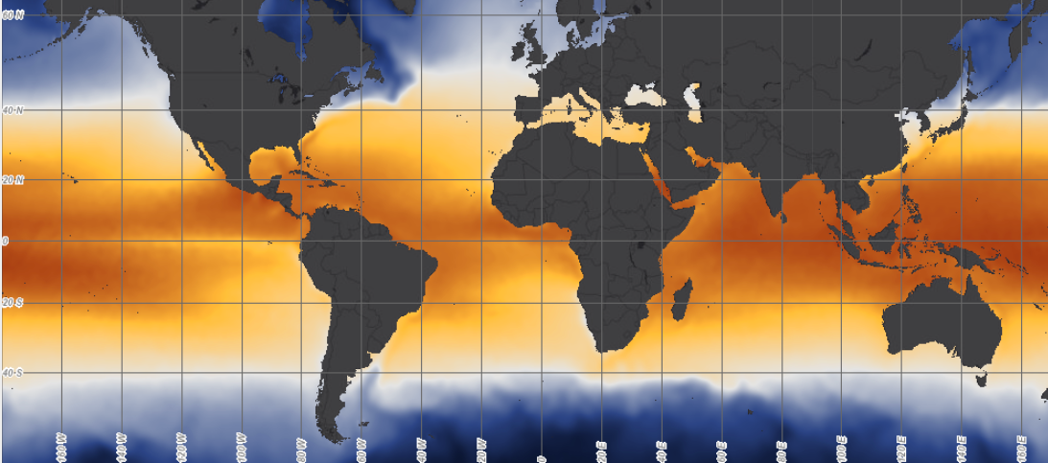
DATA IN THE CLASSROOM: LEVEL 1
Coral Reef Locations
Reading Sea Surface Temperature Maps: Coral reefs face numerous hazards and threats both globally and locally. To carefully monitor the ocean temperatures that coral reefs are exposed to, scientists use highly detailed maps of sea surface temperature (SST). To monitor SST across the planet, scientists frequently use data from satellites. By plotting the data values as colors on a map, called a false-colored map, it is easy to spot patterns of temperature and how they change across the map and at different times. Explore the interactive maps in Level 1 and fill in the blanks below.
Coral Reef Habitat and Range Coral reefs have a very limited distribution around the planet. Explore the interactive maps in Level 1 and fill in the blanks below.
What is the average temperature at 160 °East and 10°North?
Between which latitudes do most of the warmest temperatures (orange-red) occur?
Type your answers directly into the boxes.
Latitude: | Corals reefs are generally located between ________ °North and ________ °South
Temperature: | Most corals survive in temperatures ranging from ________ to ________ °Celsius.
Type your answers directly into the boxes.

Slide 2
DATA IN THE CLASSROOM: LEVEL 2
Measuring Coral Heat Stress
Measuring Water that is Warmer than Normal: In 2017, an oceanic heat wave caused severe coral bleaching at reefs across the globe. It was the worst bleaching event in history. To what extent were corals on the Great Barrier Reef at risk? Explore the graph showing real temperature data (collected by satellites) along the Great Barrier Reef during Summer 2017, and answer the questions below.
Calculating Heat Stress from Satellite Data: Prolonged and severe heat stress, like the kind that corals from the Great Barrier Reef experienced in 2017, can add up. This accumulation of stress makes significant bleaching more likely and recovery more difficult. Use the graph showing sea surface temperature values above the bleaching limit line to answer the questions below.
Understanding Degree Heating Weeks: How do DHW values correlate with coral bleaching intensity? In general, when DHW values are 0, there is no stress. When DHW is equal to 4, significant bleaching is expected. When DHW is equal to 8, widespread bleaching and mortality is expected. Zoom into the map of the Great Barrier Reef, and answer the question below.
Question | Answer
On the Great Barrier Reef, how warm does the water need to be for corals to bleach?
How many weeks did the temperatures exceed the ‘bleaching limit’ during the 3 months summer season?
How many degrees above the bleaching limit did the sea surface temperature rise during the week of February 18th, 2017?
Type your answers directly into the boxes.
Question | Answer
Calculate Degree Heating Weeks (DHW) by adding up the number of degrees above the bleaching limit over the 12 week time period.
Why is this calculation useful?
Type your answers directly into the boxes.
Were the corals on the Great Barrier Reef at high risk, moderate risk or low risk of bleaching due to heat stress? Support your answer using evidence & data from the map.
Type your answers directly into the box.

Slide 3
DATA IN THE CLASSROOM: LEVEL 3
Monitoring Coral Reefs
Identifying the Effect of Bleaching on Coral Reefs: Use the map tool to visit each of the four coral reefs in the western Pacific. Examine the photos and complete the table below. As an example, Reef #1 is partly completed for you.
Making Sense of Your Observations: Use the observations above to answer the following questions.
Coral Reef # | Reef Name and Location | Time period | Observations
1 | Phoenix islands, Republic of Kirabati | 2004 | healthy bleached dead Other observations: Coral is bright green and yellow. Lots of colorful fish are present.
1 | Phoenix islands, Republic of Kirabati |  | healthy bleached dead Other observations:
2 | Pago Pago, American Samoa |  | healthy bleached dead Other observations:
2 | Pago Pago, American Samoa |  | healthy bleached dead Other observations:
3 | Lizard Island, Great Barrier Reef, Australia |  | healthy bleached dead Other observations:
3 | Lizard Island, Great Barrier Reef, Australia |  | healthy bleached dead Other observations:
4 | Kahului Point, Maui, Hawaii |  | healthy bleached dead Other observations:
4 | Kahului Point, Maui, Hawaii |  | healthy bleached dead Other observations:
Type your answers directly into the boxes.
Question | Answer
How many of the reefs you visited showed signs of bleaching?
Has the health of these coral reefs changed over time? If yes, describe the changes you observed.
Type your answers directly into the boxes.

Slide 4
DATA IN THE CLASSROOM: LEVEL 3
Monitoring Coral Reefs
Monitoring Coral Health Using Quadrat Sampling:
Procedure: Select (click) a reef to monitor. Follow the online instructions, and record your data in the table. When you are done collecting data, calculate the percent dead and bleached. Example: An example using the photo from Reef #1 is shown below.
Data table:
Analyzing Your Data:
Square # | Is Coral Dead? 0 = coral is alive 1 = coral is dead | Is Coral Bleached? 0 = unbleached 10 = completely bleached
4 | 1
16 | 0 | 3
Leave blank since coral inside this square is dead
Reef #:
Square # | Is Coral Dead? 0 = coral is alive 1 = coral is dead | Is Coral Bleached? 0 = unbleached 10 = completely bleached
 | Sum the squares above to calculate the total squares dead | Average the values above to calculate the extent of bleaching
 | Calculate percent dead (total x 10) | Calculate percent bleached (average x 10)
Describe the health of of the area you monitored using observations and data from the table above.
In order to monitor the health of this reef over time, you need to collect more data. How often do you think you should return to collect data (weekly, monthly, yearly)? And during which seasons? Why?

Slide 5
DATA IN THE CLASSROOM: LEVEL 4
Identifying a Bleaching Event
Analyzing Data From the Florida Keys: To what extent is heat stress affecting the health of Florida’s coral reefs? Collect & analyze evidence from the Degree Heating Weeks data on the interactive map & from Mote Marine Lab’s website. Record your observations in the table below.
Construct an Explanation: Is heat stress affecting the health of Florida’s coral reefs? Use the claim, evidence, reasoning format to construction an explanation below.
Graph: Were the corals in the Florida Keys at high risk, moderate risk or low risk of bleaching due to heat stress during the last 4 years? Describe data and trends shown on the graph.
Observations from Condition Report: Where did bleaching occur in the Florida Keys during the past year(s). How severe was it? Describe specific data & observations from the report.
Type your answers directly into the boxes.
To what extent is heat stress affecting the health of Florida’s coral reefs? | My Claim:
Include specific data from your table above. | My Evidence:
Connect the evidence to your claim | My Reasoning:
Type your answers directly into the boxes.

Slide 6
DATA IN THE CLASSROOM: LEVEL 5
Design an Investigation
Develop Your Question: Ask a question that can be answered using the data available in Level 5 of the module. Some sample questions are below.
How has sea surface temperature affected the health of coral reefs near the Galapagos, Hawaii, Fiji, or the Great Barrier Reef in the past 12 months?
How has changing sea surface temperature affected the frequency and intensity of coral bleaching at the Great Barrier Reef since 2000?
Which coral reef is most at risk of bleaching due to rising sea surface temperatures: Florida Keys, Galapagos, Hawaii, or the Great Barrier Reef?
Collect Data: Collect the data that you need to answer your question using the data tools from Level 5. If possible, paste or attach any relevant graphs or data tables below (or in a separate document) .
Construct an Explanation: Use the claim, evidence, reasoning format to construction an explanation below.
Identify a question of interest about coral bleaching.
Type your answer directly into the box.
Claim: Record a simple statement that answers your question and is based upon evidence.
Evidence: Include specific data from the the data maps or graphs you have analyzed.
Reasoning: Connect the evidence to your claim.
Type your answers directly into the boxes.

