Slide 1
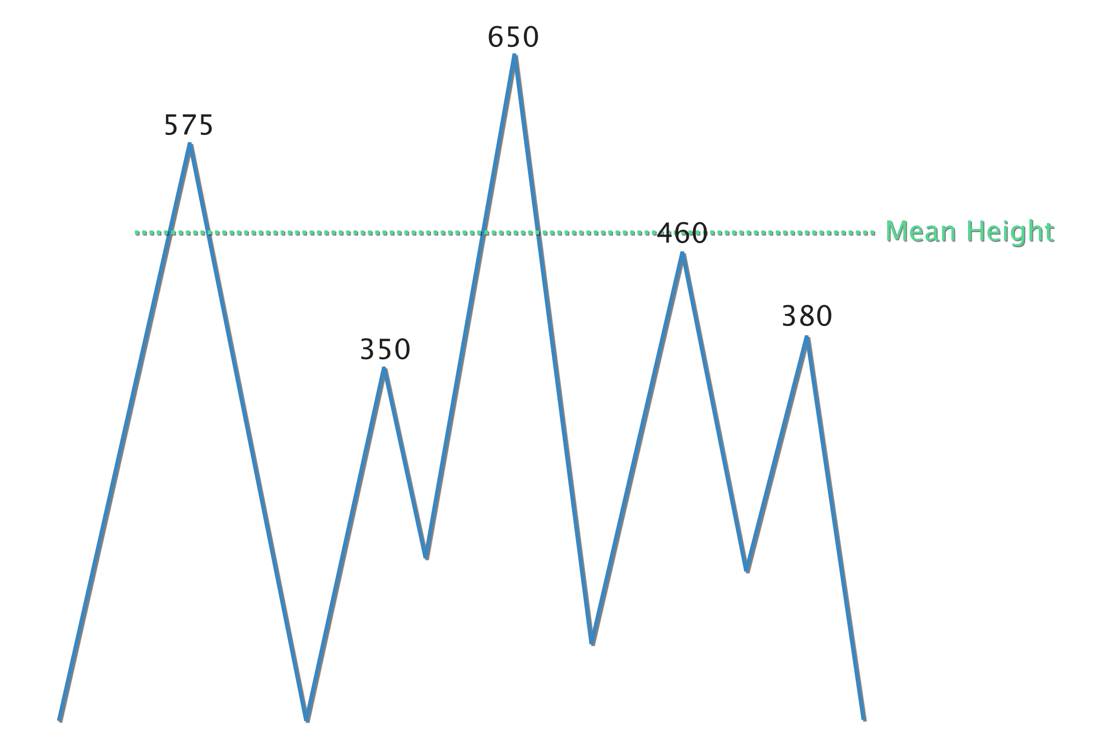
DATA IN THE CLASSROOM: LEVEL 1
How is Sea Level Calculated?
Understanding the Mean: Understanding the concept of a mean is important to interpreting sea level data.
Calculating the Mean: Imagine that at a particular location, the sea level (also known as sea surface height) was measured 5 times. These 5 measurements are shown in the diagram below.
Calculating the Deviation from the Mean: Sea surface height data and local tide gauge data are both reported as deviations from an expected or mean height. Once the mean is calculated, any measurement that is different than the mean is called a deviation. Some deviations are above the mean and some are below the mean.
How do you calculate the mean? Answer the question using words or a formula (or both).
Type your answers directly into the box.
Sea Surface Height Measurements (cm) | Calculate the mean of the 5 measurements. Show your work.
Type your answers directly into the box.
How do you calculate deviation? Answer the question using words or a formula (or both).
Type your answers directly into the box.
Sea Surface Height Measurement (cm) | What is the deviation between each measurement and the mean (from question 2)? Show your work.
575
350
650
460
380
Type your answers directly into each of the 5 rows in the table.

Slide 2
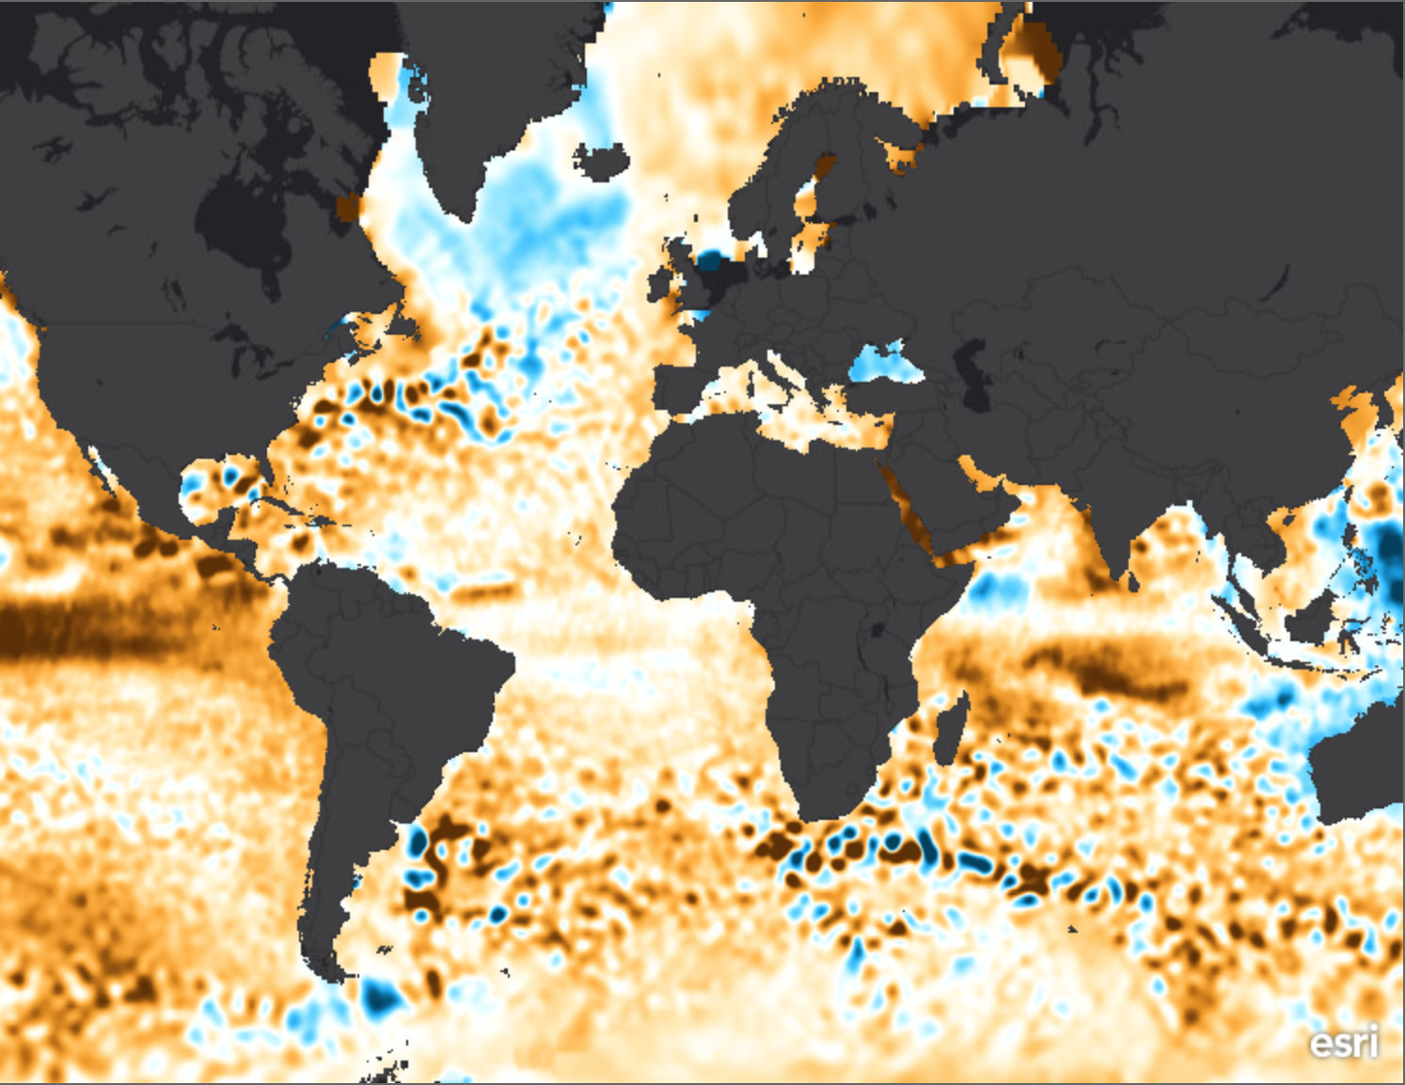
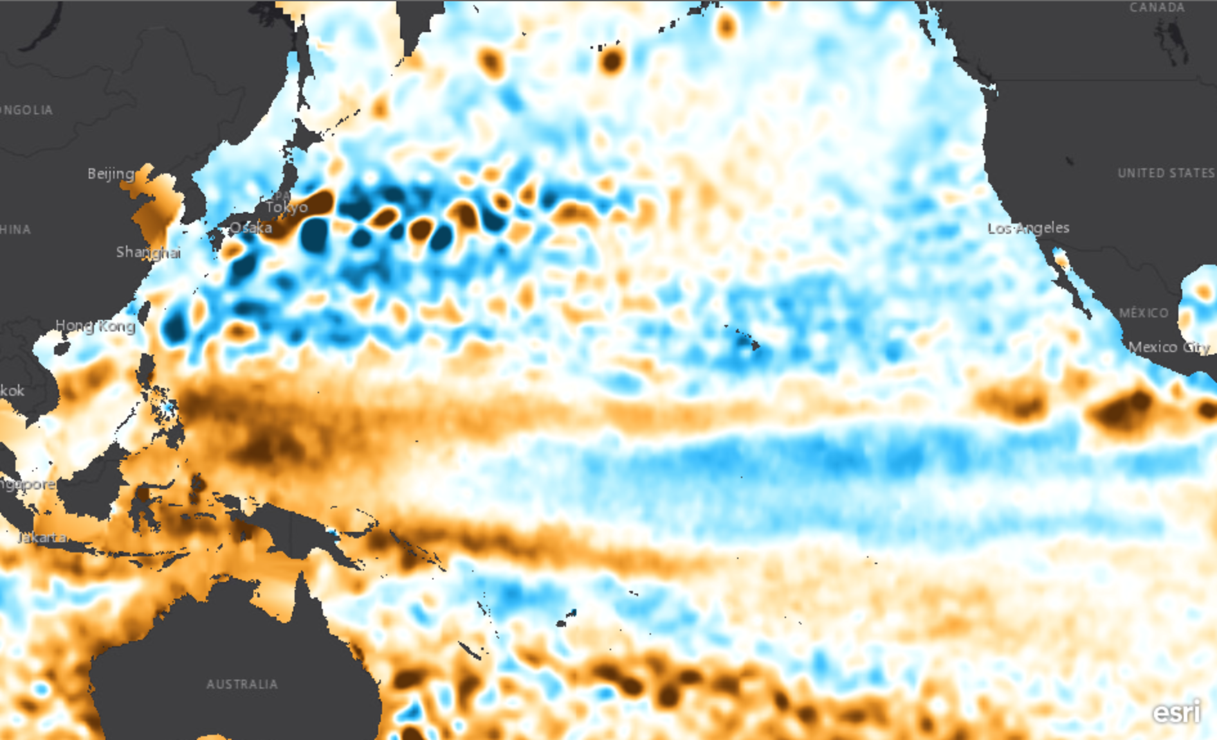
DATA IN THE CLASSROOM: LEVEL 2
How Much Do Sea Levels Vary?
Understanding ‘Sea Surface Height Deviation’:
Interpreting Global Sea Level Data: Let’s examine a data map that shows sea surface height deviations (SSHD) over the entire planet from January 2016.
Comparing Sea Levels Across the Pacific: How much do sea levels vary across the Pacific Ocean? Examine the SSHD data map from April 2013 to help you find out.
What is Sea Surface Height Deviation? Use both words and a formula in your description.
Type your answer directly into the box.
 | Question | Answer
 | What do the yellow and orange colors on the map represent?
 | In January 2016, what was the approximate SSHD off the coast of Los Angeles, USA?
Los Angeles
Type your answers directly into the boxes.
 | How is the sea level in the western Pacific different than the eastern Pacific? | My claim:
 | Include specific data measurements from the map | My evidence:
 | Connect the evidence to your claim | My reasoning:
Type your answers directly into the boxes.
Propose an explanation for the change in sea level across the Pacific Ocean.
Need help? Refer back to the beginning of Level 1 for ideas.

Slide 3
DATA IN THE CLASSROOM: LEVEL 2
How Much Do Sea Levels Vary?
Comparing Sea Levels Over Time: How much have sea levels changed over time? Compare the SSHD data maps from December 1993 and December 2016 to find out.
 | How have sea levels changed globally, from 1993 to 2016? | My claim:
 | Include specific data measurements from the map | My evidence:
 | Connect the evidence to your claim | My reasoning:
1993
2016
Type your answers directly into the boxes.
Los Angeles
Propose an explanation for the change in sea level over time.
Type your answers directly into the boxes.

Slide 4
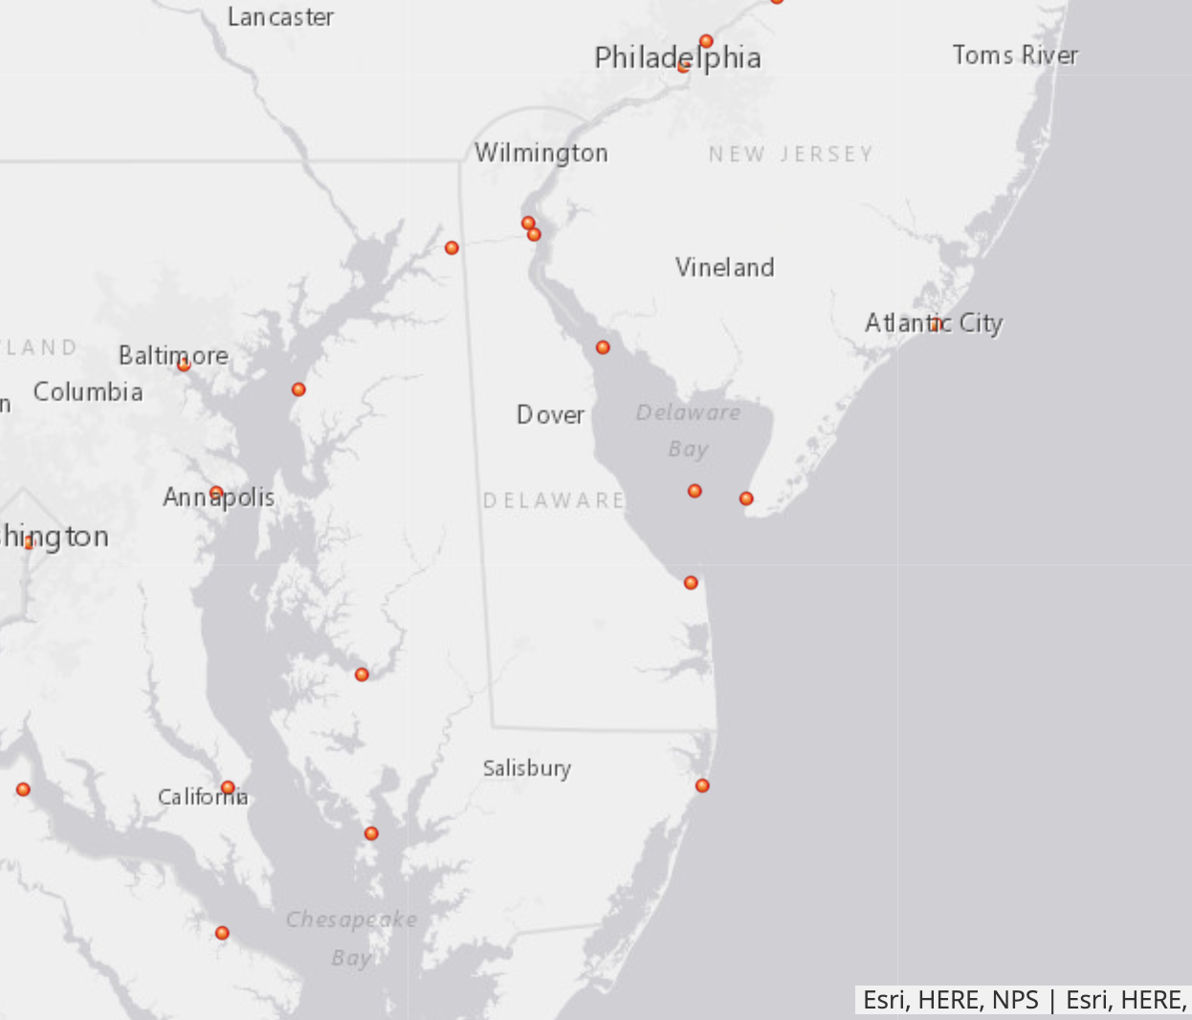
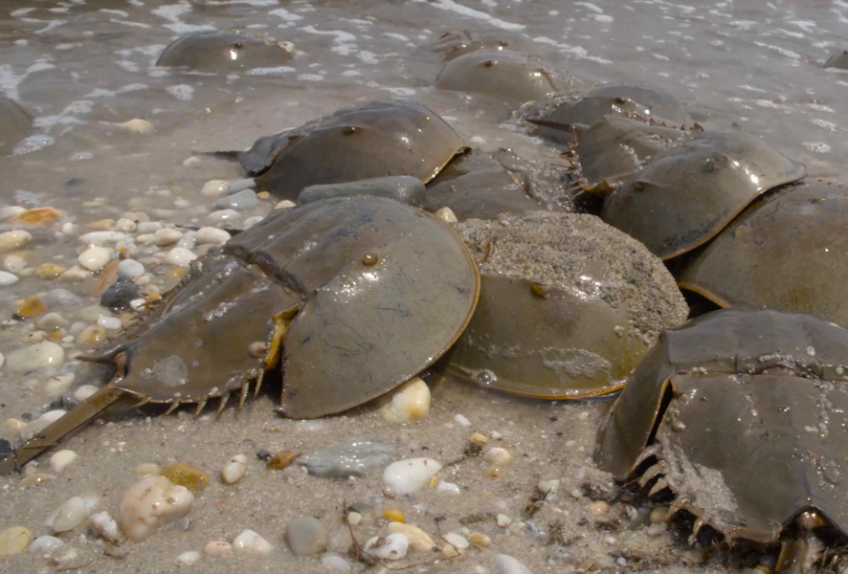
DATA IN THE CLASSROOM: LEVEL 3
How Do Tides Affect Sea Level?
How Does Moon Phase Affect the Tides? The position of the Moon relative to Earth and the Sun affects not only the apparent shape of the Moon from Earth, but also its pull on the tides. Observe each of the Moon phases in the online activity. Then answer the question below.
Interpreting a Tide Chart: Let’s examine a tide chart that shows the changing tides in Monterey, California over a three day period. Use the chart to answer the questions below.
Answering a Question with Tide Data:
Your Question: Travel back in time to May 2016. You are taking a trip to Delaware to see the largest concentration of spawning horseshoe crabs in the world. Spawning is highest during the new and full moons, and the highest numbers of crabs are often present during high tides that occur at night. What is likely the best date and time to see horseshoe crab spawning in May 2016?
Get the Data: Produce a tide chart, as instructed in the online activity. Use the chart to answer the questions below.
What do you notice about the rise and fall of the tides during each phase of the moon (from new moon to full moon)? Take note of any observed similarities and differences.
Type your answer directly into the box.
 | Calculate the tidal range: The difference in height between a high tide and a succeeding low tide.
 | Calculate the tidal period: The length of time between consecutive low tides or consecutive high tides.
Type your answers directly into the boxes.
 | What is likely the best date and time to see horseshoe crab spawning in May 2016? | My claim:
 | Include specific data from the tide chart. | My evidence:
 | Connect the evidence to your claim | My reasoning:
Type your answers directly into the boxes.
Horseshoe crab spawning in the Delaware Bay Image: NOAA Ocean Today

Slide 5
DATA IN THE CLASSROOM: LEVEL 3
How Do Tides Affect Sea Level?
Make a Model: Draw a diagram of the approximate orientation of the Moon relative to the Earth and Sun on the date that you concluded would be the best time to see horseshoe crab spawning (from Question 3). Color a blue tidal bulge around the earth, indicating an approximate spring tide or neap tide. Label all parts of your diagram.

Slide 6
DATA IN THE CLASSROOM: LEVEL 4
How Do Storms Affect Sea Level?
How Do Storms Affect Sea Level?
Research Project – Determining Storm Surge Height
Your Mission: You are joining a team of scientists who are studying the effects of storms along the U.S. coast. Your task is to pick a storm event for a coastal location and gather data about the water height before, during, and after the storm. What effect did the storm have on local sea levels?
Make a Claim: Use the internet and search for news stories using keywords such as 'flooding,' and 'storm tides.' Include the location you are interested in, such as 'Miami, Florida.' Once you have found a storm to study, complete the table below.
Collect Evidence: Use the tide data tool to produce a tide chart, as instructed in the online activity. Use the chart & the moon phase calendar to answer the questions below.
What causes sea levels to change during a storm? Use the term ‘storm tide’ in your answer.
Type your answer directly into the box.
Record the date(s) when flooding occurred.
Record the location(s), coastal cities or beaches where the flooding occurred.
Develop a claim about the storm you identified above. See the example below. Example: The tides caused flooding from Hurricane Dorian to be more severe in West Palm Beach, Florida.
Type your answers directly into the boxes.
On the tide chart, is there evidence that the sea levels were higher than expected during the storm? If yes, how can you tell?
What was the height of the highest storm tide?
At the time of the highest storm tide, how much did the sea level rise above the predicted sea level?
What was the approximate moon phase during the storm (use the online moon phase calendar)?
Was the monthly tidal cycle in a spring or neap phase?
Type your answers directly into the boxes.

Slide 7
DATA IN THE CLASSROOM: LEVEL 4
How Do Storms Affect Sea Level?
Research Project – continued
Analyze Your Storm Data:
Explain why you think each piece of evidence supports your claim. If possible, paste or attach your tide chart(s) to this document.
Type directly into the box.

Slide 8
DATA IN THE CLASSROOM: LEVEL 5
Design an Investigation
Develop Your Question: Ask a question that can be answered using the data tools in the Sea Level module. The available tools are described below.
Sea Surface Height - Map Viewer (1992 - 2016): This data visualization can be used to identify long-term changes in global sea surface height over time.
Sea Surface Height Data Tool (1993 - present): This data tool will enable students to download global Sea Surface Height Deviation (SSHD) maps. Students may also make their own graphs using the data tool and a spreadsheet program such as Google Sheets or Microsoft Excel.
Tide Data Tool: This tool allows students to search and access tide data for 236 locations around the United States, territories in the Pacific, and Bermuda.
NOAA Sea Level Rise Viewer: this interactive map will allow you to visualize the potential impacts of rising sea levels on coastal areas. By moving the slider bar at the upper left of the page, you can increase sea levels up to 6 ft.
Collect Data: Identify the data that you need to answer your question. If possible, paste or attach your data maps or charts to this document.
Use the claim, evidence, reasoning format to help answer your question.
Identify a question about sea level at a location(s) of interest.
Type your answer directly into the box.
Data | Date | Map or Graph
Example: Sea Surface Height Deviation | December 1995 & December 2015 | Map
Type your answers directly into the boxes.
Claim: Record a simple statement that answers your question and is based upon evidence.
Evidence: Include specific data from the the data maps, graphs or charts you have analyzed.
Reasoning: Connect the evidence to your claim.
Type your answers directly into the boxes.

